Slide 1
Expressing one number as a fraction of another
Understanding multiplicative relationships: fractions and ratio

Slide 2
how to use Oak lessons

Slide 3
I can express one number as a fraction of another.

Slide 4
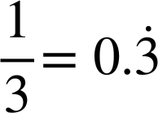
The reciprocal is the multiplicative inverse of any non-zero number. Any non-zero number multiplied by its reciprocal is equal to 1.
A terminating decimal is one that has a finite number of digits after the decimal point.
Example
Example
Non example
Non example

Slide 5

Expressing one number as a fraction of another
Finding the multiplier efficiently
Writing one number as a fraction of another

Slide 6
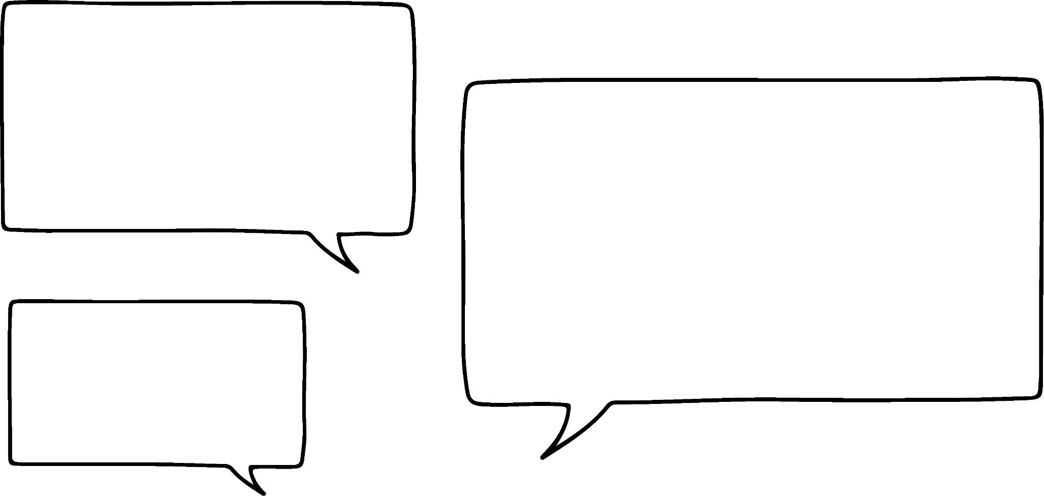


Finding the multiplier efficiently
Lucas and Sam are trying to find the missing numbers in the following:
3 | × |  | = | 6
3 | × |  | = | 39
3 | × |  | = | 81
3 | × |  | = | 4.5
Remember you can use the inverse of multiplication.
I can do the first 2 but then I get a little bit stuck.
Of course, I can do 81 ÷ 3 for the 3rd one.
Sam
Lucas

Slide 7
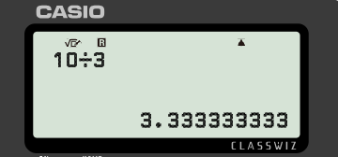
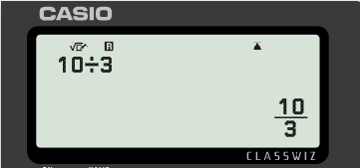
Finding the multiplier efficiently
3 × 3.3 = 10
10 ÷ 3 = 3.3
I’ll check that 3.33333333 × 3 = 9.99999999
If 10 ÷ 3 = 3.3, then doesn’t that mean that 3.3 × 3 = 10?
It should, but 3.3 × 3 = 9.9
Oh, I should have written 3.33333333 and not 3.3
So, that is still not right.
Lucas
Sam
Let’s take a look at what they typed into the calculator.
Lucas should have used the fraction as this is the exact value of 10 ÷ 3.

Slide 8





Finding the multiplier efficiently
In maths we should use the exact value in our calculations where appropriate.
3 × = 16
3 × =
3 × =

Slide 9










Finding the multiplier efficiently
Match the following:
Which of these could be written as terminating decimals?
5 | × |  | = | 3.75
 | × | 5 | =
5 | × |  | =
 | × | 5 | =
5 | × |  | = | 7.5
 | × | 5 | =

Slide 10
Finding the multiplier efficiently
3 m
I bought this piece of material for £10.50
£10.50
I really like that material Lucas. I would like to get some but I would need 6 metres. How much will that cost?
Lucas
× 2
3
6
Length (m)
Cost (£)
?
It will cost Sam £21 to buy 6 metres of the same material.
10.50
21
Sam
× 2

Slide 11

Finding the multiplier efficiently
How could we use the double number line to find the cost of 10 metres?
×
× ?
What is the multiplicative relationship between 3 and 10?
3
10
Length (m)
Cost (£)
10.50
35
?
It will cost £35 to buy 10 metres of the same material.
×

Slide 12

Finding the multiplier efficiently
A recipe requires 195 grams of chocolate chips to bake 30 cookies.
What weight of chocolate chips would you need to make 250 cookies?
×
30
250
Cookies
Chocolate chips (g)
195
1625
?
You need 1625 grams to make 250 cookies.
×

Slide 13


Finding the multiplier efficiently
Complete this double number line:
Complete this double number line:
×
×
30
115
30
70
Packets
Packets
Cost (£)
Cost (£)
25.80
98.90
8.40
?
19.60
?
×
×
115 packets will cost £98.90
70 packets will cost £19.60

Slide 14
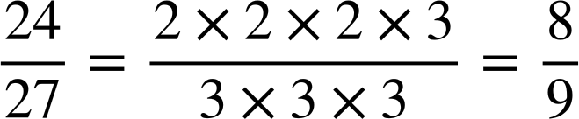
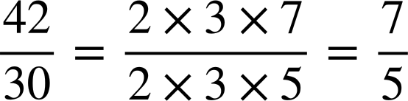
Finding the multiplier efficiently
Find the multiplier:
Find the multiplier:
Input
Output
Input
Output
× ?
× ?
27
24
30
42
The multiplier is
The multiplier is

Slide 15



Finding the multiplier efficiently
Complete this table:
Input | Output | Multiplier
16 | 40
18 | 12
35
 | 276
253
x | 5x
 | 8x | 0.5 or
3x

Slide 16
Finding the multiplier efficiently
2) Complete these double number lines:
a)
×
b)
×
42
102
35
84
Packets
Packets
Cost (£)
Cost (£)
10.08
44.52
×
×
102 packets will cost .
35 packets will cost .

Slide 17

Finding the multiplier efficiently
Complete this table:
Input | Output | Multiplier
16 | 40 | 2.5 or
18 | 12
35 | 60
72 | 276
253 | 69
x | 5x | 5
16x | 8x | 0.5 or
3x | 5x

Slide 18


Finding the multiplier efficiently
2) Complete these double number lines:
a)
×
b)
×
42
102
35
84
Packets
Packets
Cost (£)
Cost (£)
10.08
24.48
18.55
44.52
×
×
102 packets will cost £24.48
35 packets will cost £18.55

Slide 19
Expressing one number as a fraction of another
Finding the multiplier efficiently
Writing one number as a fraction of another

Slide 20

Writing one number as a fraction of another
What fraction of 30 is 20?
30
10
20
20 is of 30
20
Notice this is
in its simplest terms.

Slide 21

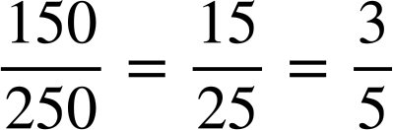
Writing one number as a fraction of another
What fraction of 250 is 150?
250
150
150 is of 250
150

Slide 22
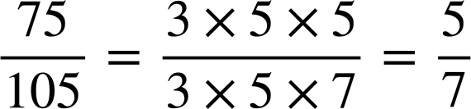
Writing one number as a fraction of another
We could represent this type of problem on a double number line.
What fraction of 105 is 75?
×
?
1
Fraction
Amount
75
105
75 is of 105
×
?

Slide 23


Writing one number as a fraction of another
Lucas and Sam have drawn a double number line to answer this question.
What fraction of 45 is 18?
Lucas’ method:
Sam’s method:
×
×
1
? =
? =
1
Fraction
Fraction
Amount
Amount
18
45
18
45
×
×
Whose number line is correct?
Sam’s method is correct.

Slide 24
Writing one number as a fraction of another
Lucas’ method:
Sam’s method:
×
×
1
? =
? =
1
Fraction
Fraction
Amount
Amount
18
45
18
45
×
×
What mistake has Lucas made?
He has marked 18 as the ‘whole’.
What question does Lucas’ number line represent?
What fraction of 18 is 45?

Slide 25
Writing one number as a fraction of another
18 is of 45
45 is of 18
I’ve noticed that the fractions are reciprocals of each other.
Oh yes, you are right Lucas.
Lucas
Sam

Slide 26


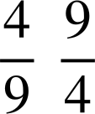
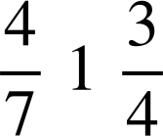
Writing one number as a fraction of another
Complete the following:
24 is of 64, so 64 is of 24
6804 is of 3024, so 3024 is of 6804
80.5 is of 46, so 46 is of 80.5

Slide 27

Writing one number as a fraction of another
What fraction of 144 is 120?
What fraction of 84 is 35?
×
×
?
1
?
1
Fraction
Fraction
Amount
Amount
120
144
35
84
35 is of 84
×
×
120 is of 144

Slide 28











Writing one number as a fraction of another
What fraction of A is B? Write all answers in their simplest form.
A | B
35 | 90
42 | 72
531 | 354
154 | 182
63 | 175
154 | 110
90 | 75
108 | 96
69 | 437
255 | 595
Shade the answers in the grid. They appear more than once.
What fraction of 123 is the revealed number?

Slide 29
Writing one number as a fraction of another
What fraction of A is B? Write all answers in their simplest form.
A | B
35 | 90
42 | 72
531 | 354
154 | 182
63 | 175
154 | 110
90 | 75
108 | 96
69 | 437
255 | 595
Shade the answers in the grid. They appear more than once.
What fraction of 123 is the revealed number?

Slide 30
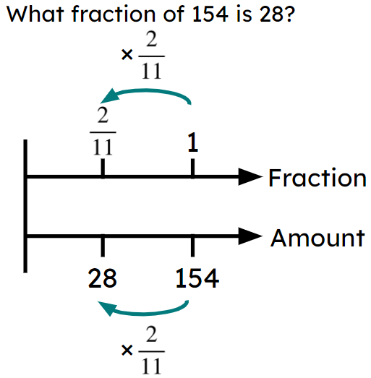
Expressing one number as a fraction of another
To find a multiplier you divide the 2 numbers.
You must always use the exact value. If the multiplier is not an integer or terminating decimal you must use the fraction. E.g. not
To write a number as a fraction of another you can use a double number line. E.g.

Slide 31

© Oak National Academy 2023.
Produced in partnership with Mathematics in Education and Industry.
Licensed on the Open Government Licence v3.0, except where otherwise stated. See Oak terms and conditions.

